Slide 1
PREVENTION AND DETECTION OF FAKE CHEQUE SCAMS USING BLOCK CHAIN
BATCH A13
TEAM MEMBERS :
SRIMANJARI P [211418104262]
SUBRINI K B [211418104270]
SWETHA A R [211418104283]
GUIDE NAME: SANTHANALAKSHMI

Slide 2
OVERVIEW
The paper aims to explore a few crucial and famous enabled offerings of banking zone, its benefits and troubles at present.
Fake cheque scam is one of the most common attacks used to commit fraud against consumers.
Currently, there is no existing solution to authenticate cheques and detect fake ones instantly.
Instead, banks must wait for a period of more time and date to detect the scam.
More precisely, our approach helps the banks to share information about provided cheque and used ones, without exposing the banks’ customers’ personal data.

Slide 3
PROBLEM DEFINITION
The threat of online fraud has spurred many charity companies and financial institutions to alert consumers when potentially fraudulent transactions are made.
Blockchain can help to reduce and even prevent fraud in the supply chain through greater transparency and improved traceability of products.
It’s very difficult to manipulate the blockchain.
In this project bank will return the check leaf to the customer when bank find the charity is fake.

Slide 4
LITERATURE SURVEY
TITLE:Blockchain-Based Solution for Detecting and Preventing Fake Check Scams
AUTHOR: Badis Hammi , Sherali Zeadally , Yves Christian Elloh Adja, Manlio Del Giudice, and Jamel Nebhen
YEAR:2021
PUBLISHED IN:IEEE Transactions on Engineering Management
METHODOLOGY: digital signature algorithm
PROS: Digital signatures provide authenticity and ensure that the signature is verified
CONS: It requires a lot of time to authenticate the verification process.

Slide 5
TITLE: The Role of Blockchain in Reducing the Cost of Financial Transactions in the Retail Industry.
AUTHOR: Emart 77, Beirut, Lebanon
YEAR:2021
METHODOLOGY: Consumer Packed Goods
PROS: Consumer packaged goods (CPG) — and to some extent, services — is arguably one of the most challenging industries to be successful in.
CONS:Another disadvantage of being consumers is the limited resources that they are forced to accept. This includes the limitations on income and the way these decisions influence consumer interest in a product.

Slide 6
TITLE: Evaluation of Tools and Extension for Fake News Detection.
AUTHOR: Dilip Kumar Sharma; Sonal Garg; Priya Shrivastava.
YEAR: 2021
METHODOLOGY:Bi-LSTM classifier.
PUBLISHED IN:IEEE international Conference on innovative practice in technology management (ICIPTM)
PROS: It is a sequence prediction model. It is a discriminative classifier which models the decision boundary between different classes.
CONS:Since BiLSTM has double LSTM cells so it is costly.Not Good
fit for Speech Recognition

Slide 7
TITLE: Integration of Blockchain and IoT (B-IoT): Architecture, Solutions, & Fuwture Research Direction.
AUTHOR: Vikash Kumar Aggarwal , Nikhil Sharma , Ila Kaushik , Bharat Bhushan , Himanshu
YEAR:2020
PUBLISHED IN :1ST international Conference on computational research and data analytics (ICCRDA)
METHODOLOGY:Integration of Blockchain and IoT
PROS:The smart contract is what allows a smart device to function on its own without the need for a centralized authority.
CONS:One of the notable weaknesses of blockchain is scalability, while blockchain is not indestructible.

Slide 8
TITLE: The Check is in the Mail: Monetization of Craigslist Buyer Scams.
AUTHOR: Jackie Jones, Damon McCoy
YEAR:2020
PUBLISHED IN:IEEE APWG SYMPOSIUM
METHODOLOGY: Conservative Classification Strategy
PROS:Compared to manual data entry, automatic data entry greatly reduce errors. Company documents can be filled out, stored, retrieved and used more accurately.
CONS:automated equipment include the high capital expenditure required to invest in automation.

Slide 9
TITLE: An Assessment of Fraud and its Management in Nigeria Commercial Banks.
Author:Abiola, Idowu
YEAR:2019
PUBLISHED IN:European Journal of Social Sciences METHODOLOGYdisadvantage Pearson Product Moment Correlation Coefficient
PROS: Acorrelation co effient such as Pearson r is that it provides effect size information (in unit free terms).
CONS : A key limitation of Pearson's r is that it cannot distinguish between independent and dependent variables. Therefore, also if a relationship between two variables is found.

Slide 10
TITLE:Simulating DDOS attacks on the us fiber-optics internet infrastructure
AUTHOR: Sumeet Kumar
YEAR : 2017
PUBLISHED IN: Proceedings of the 2017 Winter Simulation Conference
METHODOLOGY : cyber- attacks
PROS : a network simulation model to understand the Internettraffic flow pattern in a DDoS attack situation
CONS:altering data through remote access or damage the systems causing data loss

Slide 11

TITLE :Combating anonymous offenders in the cyberspace: An overview of the legal approach in Malaysia
AUTHOR: Dr Nazli Ismail Nawang
YEAR: 2017
PROS :It identifies the anonymous offender in the cyber world.
CONS :The user must know the various laws that have been enacted to govern publications of illegal content

Slide 12
TITLE: IoT honeypot: A multi-component solution for handling manual and Mirai-based attacks
AUTHOR: Haris Šemić, Sasa Mrdovic
YEAR: 08 January 2017
PUBLISHED IN:IEEE 25TH Telecommunication forum TELFOR 2017
METHODOLOGY: Internet-of-Things (IoT) devices
PROS:It is used to attain sufficient exposure to malicious traffic and security of collected data.
CONS:The plack of security has left IoT devices vulnerable to various attacks that aim to take control of said devices and utilize them for various malicious purposes

Slide 13
TITLE :Leveraging crime reporting in Metro Manila using unsupervised crowd-sourced data: A case for the Report framework.
AUTHOR : Bernie S. Fabito, Angelique D. Lacasandile, Emeliza R. Yabut
YEAR :2017
PUBLISHED IN: International Conference on control, electronics, renewable energy and communication
METHODOLOGY :Ping ER Monitoring Agent
PROS :In this layer, existing Ping ER scripts which generate hourly, monthly, and yearly reports can work seamlessly. This is because, in this framework, contents are addressed through hashes which is a widely used means of connecting data in a distributed network.
CONS :The downside of using an always-free tool is that it may be missing key features that you need. And with always-free tools, what you get is what you get.

Slide 14
TITLE: The Language and Cross-Cultural Perceptions of Deception.
AUTHOR: Wendy Baker-Smemoe, Chair David Eddington William
G. Eggington.
YEAR :2015
PUBLISHED IN: published in brigham young University
METHODOLOGY :Qualtrics Survey Block
PROS :Rather than creating two surveys, you could create two blocks of questions within one survey and randomly assign participants to one block or the other.
CONS : Qualtrics support could use some work. It can be difficult to find help in the community. I almost always have to reach out to someone on the online chat or via email to get help.

Slide 15
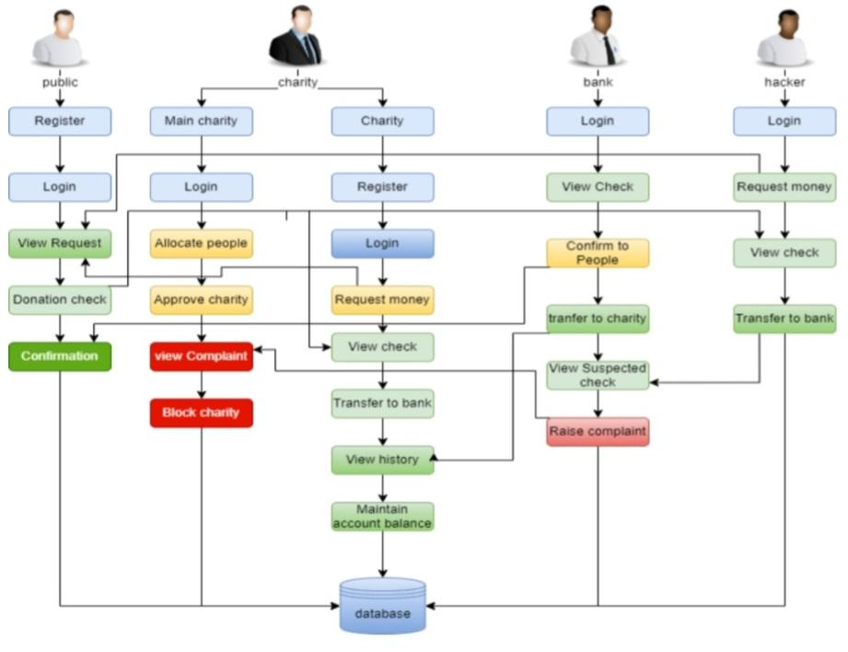
SYSTEM ARCHITECTURE

Slide 16
FEASIBILITY ANALYSIS
TECHNICAL FEASIBILITY
HARDWARE REQUIREMENTS
PROCESSOR : DUAL CORE 2 DUOS
RAM : 2 GB DD RAM
HARD DISK : 250 GB
SOFTWARE REQUIREMENTS
FRONT END : J2EE (JSP, SERVLET)
BACK END : MY SQL 5.5
OPERATING SYSTEM : WINDOWS 7
LANGUAGE : JAVA

Slide 17
ECONOMIC FEASIBILITY
This assessment typically involves a cost/ benefits analysis of the project, helping organizations determine the viability, cost, and benefits associated with a project before financial resources are allocated.
It also serves as an independent project assessment and enhances project credibility—helping decision-makers determine the positive economic benefits to the organization that the proposed project will provide.
SOCIAL FEASIBILITY
It is helpful for people to save their money from hackers
It helps the bank to detect the fake cheque instantly

